Slide 1

Ukiah Police Dept.
2025 Annual Report

Slide 2
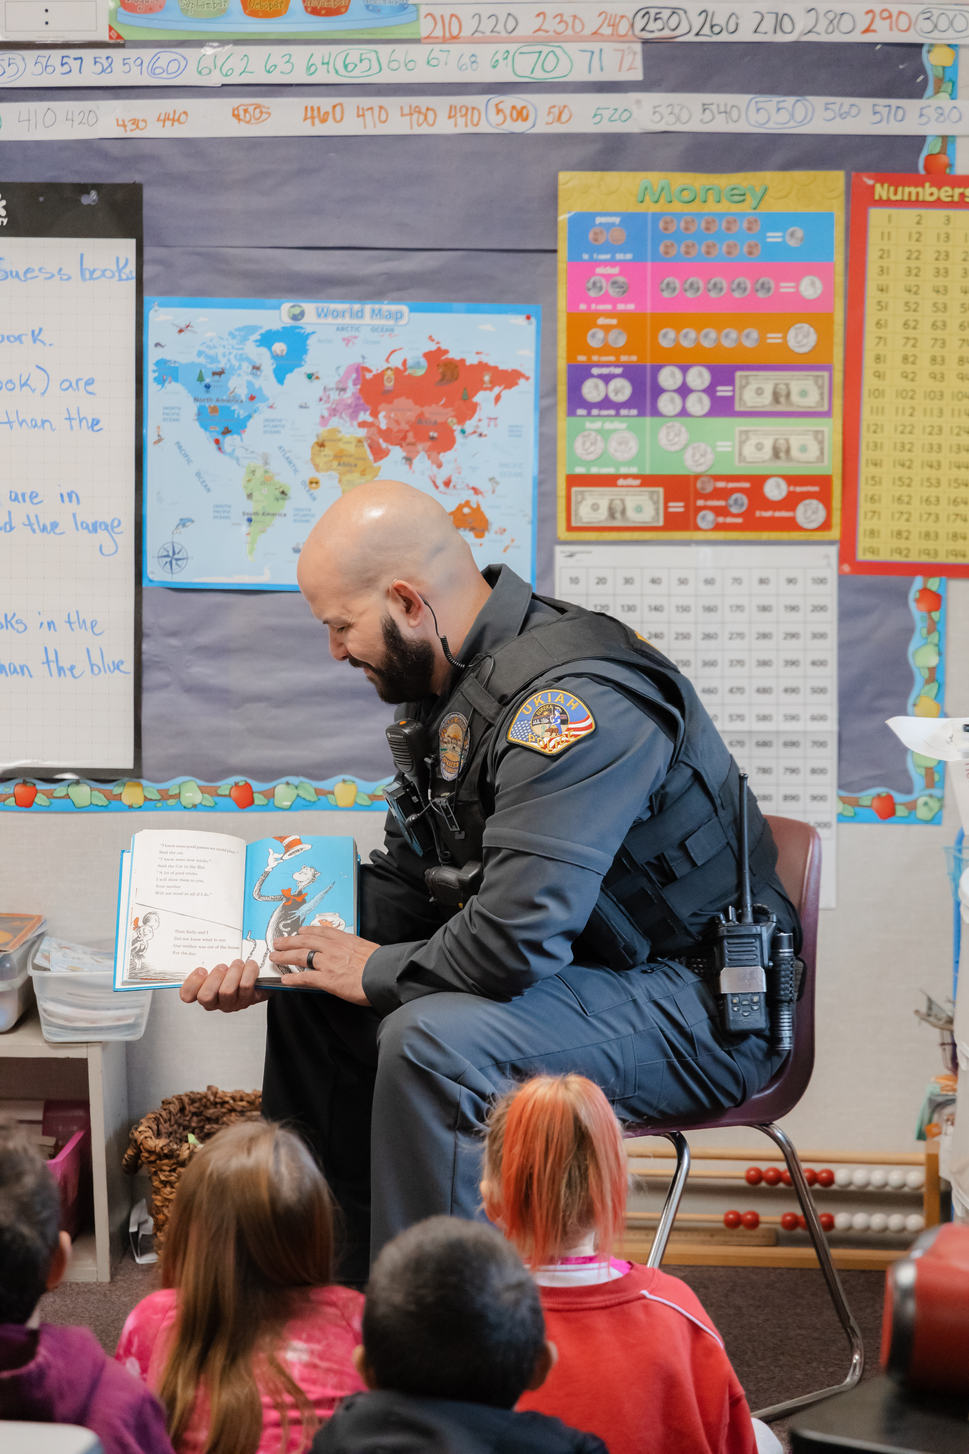
Mission
Safety: We value human life and strive to enable our citizens to be safer and less likely victimized by crime.
Professionalism: We value dedicated highly trained personnel, with a commitment to the standards of the law enforcement profession.
Community Service: We value the privilege to provide effective, efficient and equitable service. We respect the members of our community, the importance of a combined crime prevention alliance and the opportunity to provide a united policing effort.

Slide 3
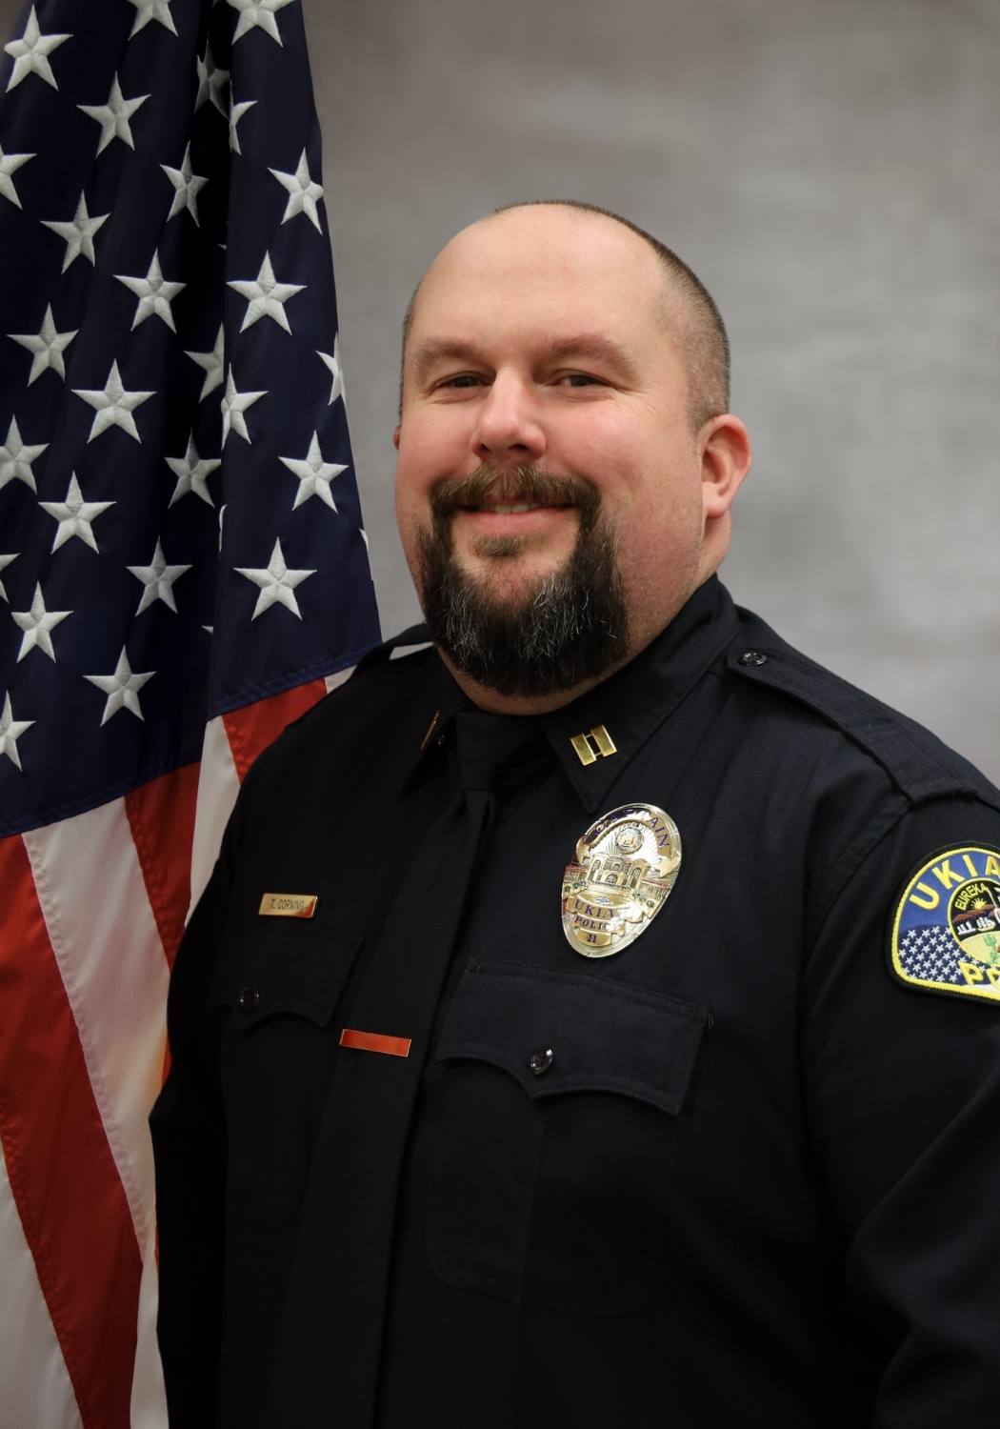
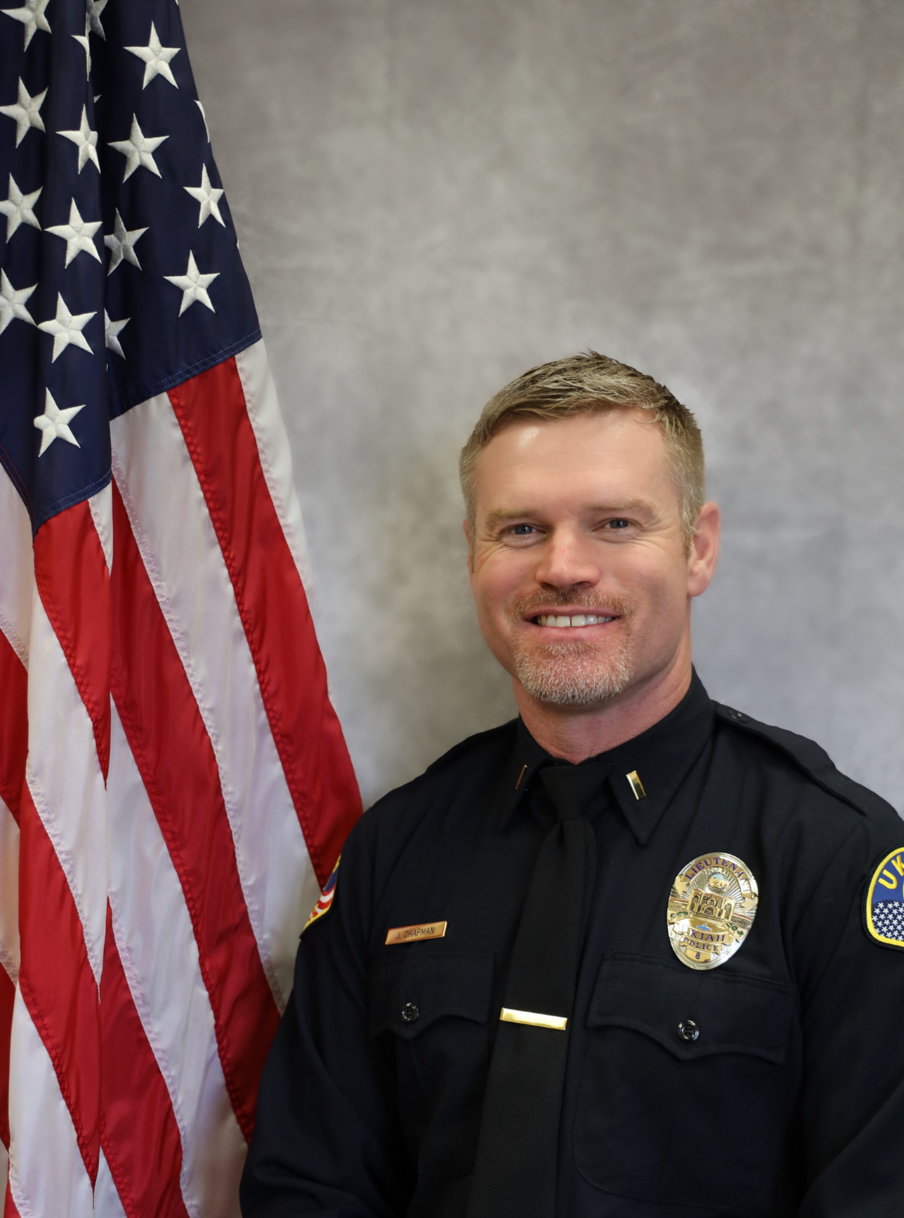
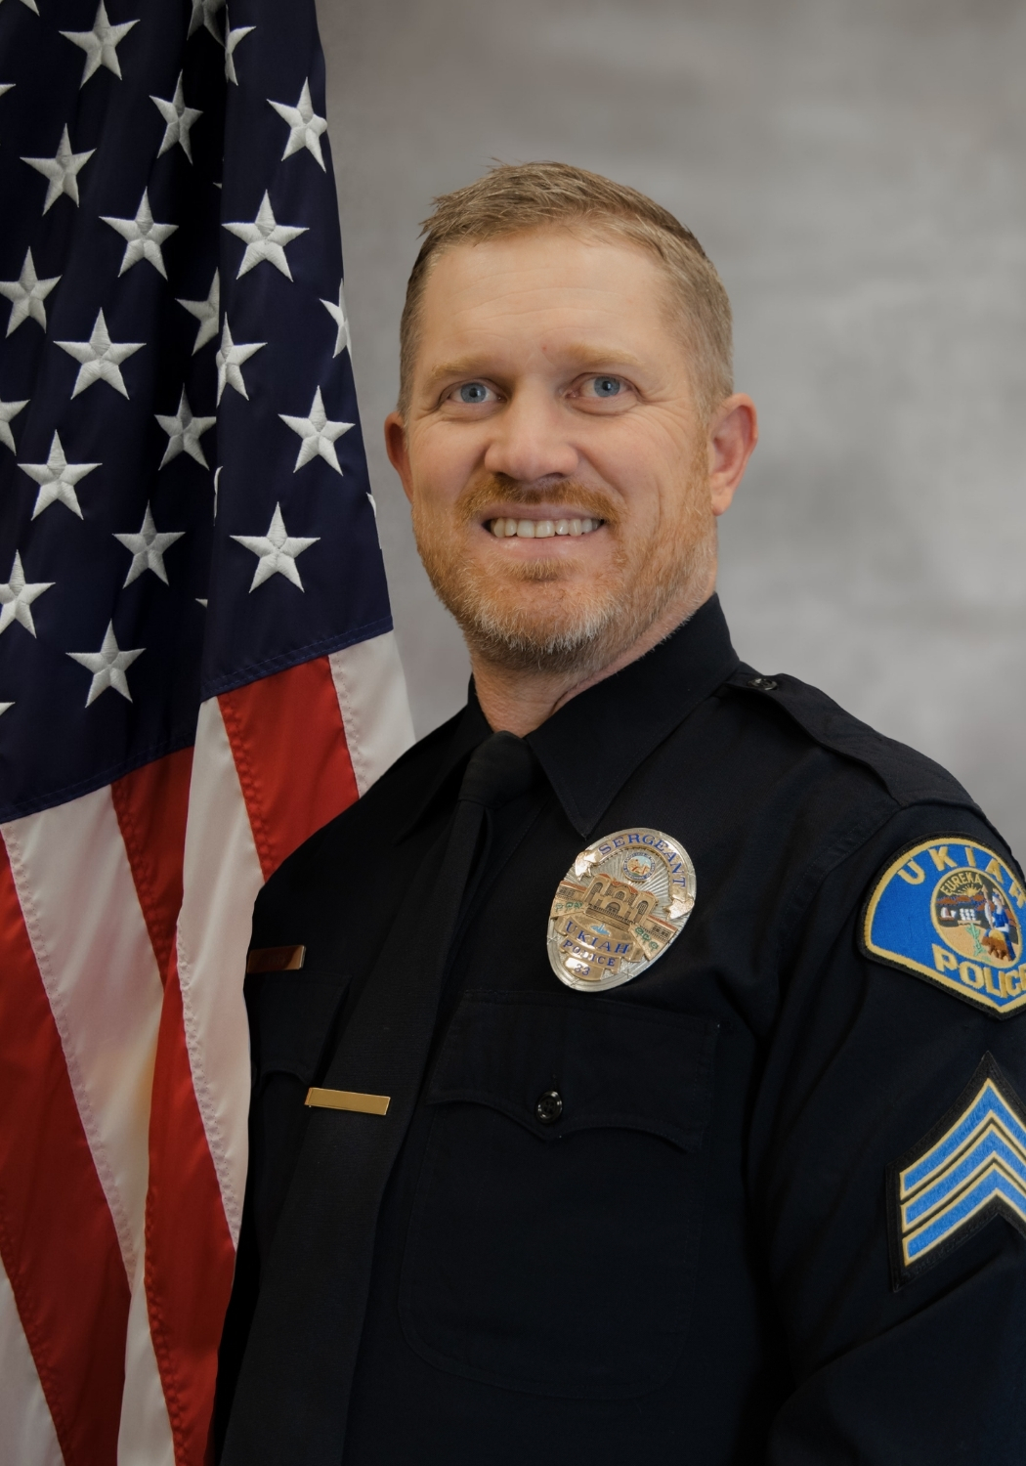
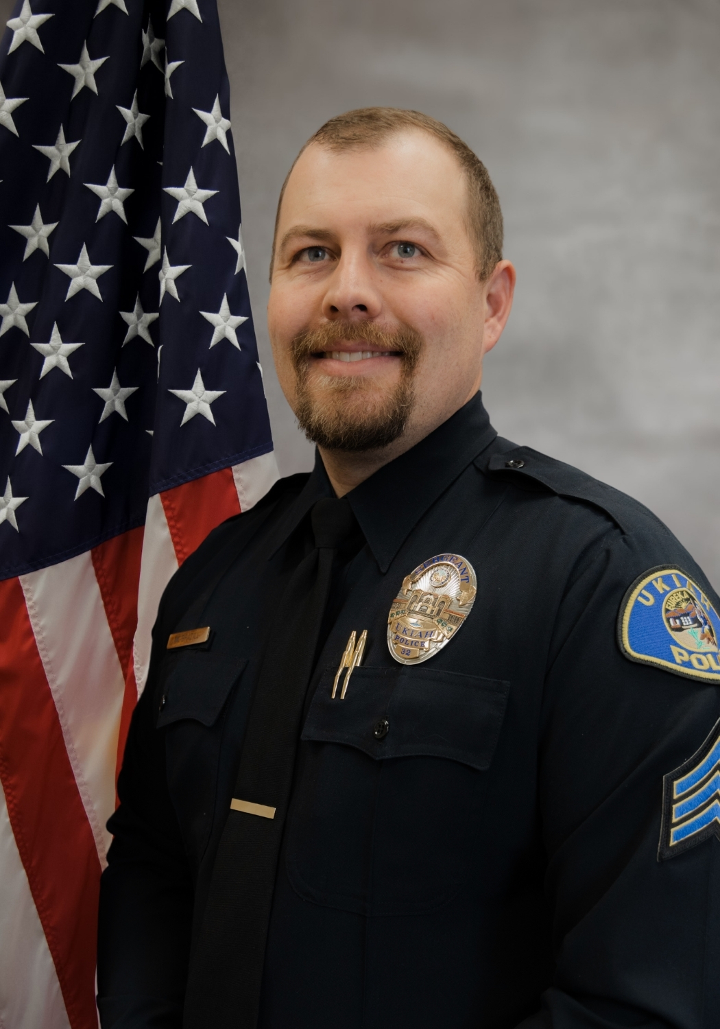
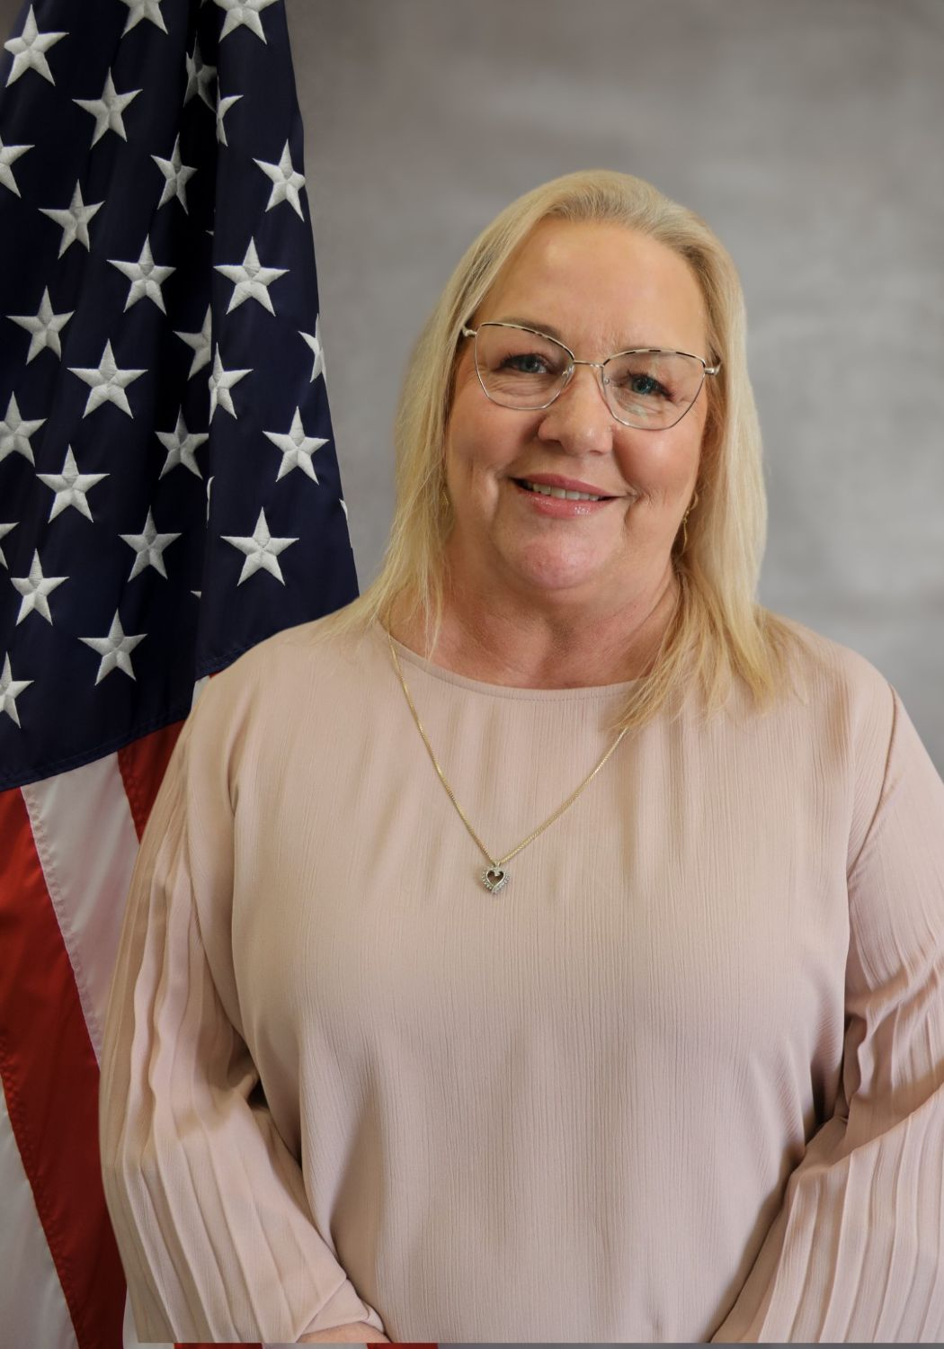
Command Staff
Chief Corning
Captain Chapman
Lt. Rigby
Patrol
Lt. Brazill
Admin
Mngr. Swan
Dispatch/Records

Slide 4
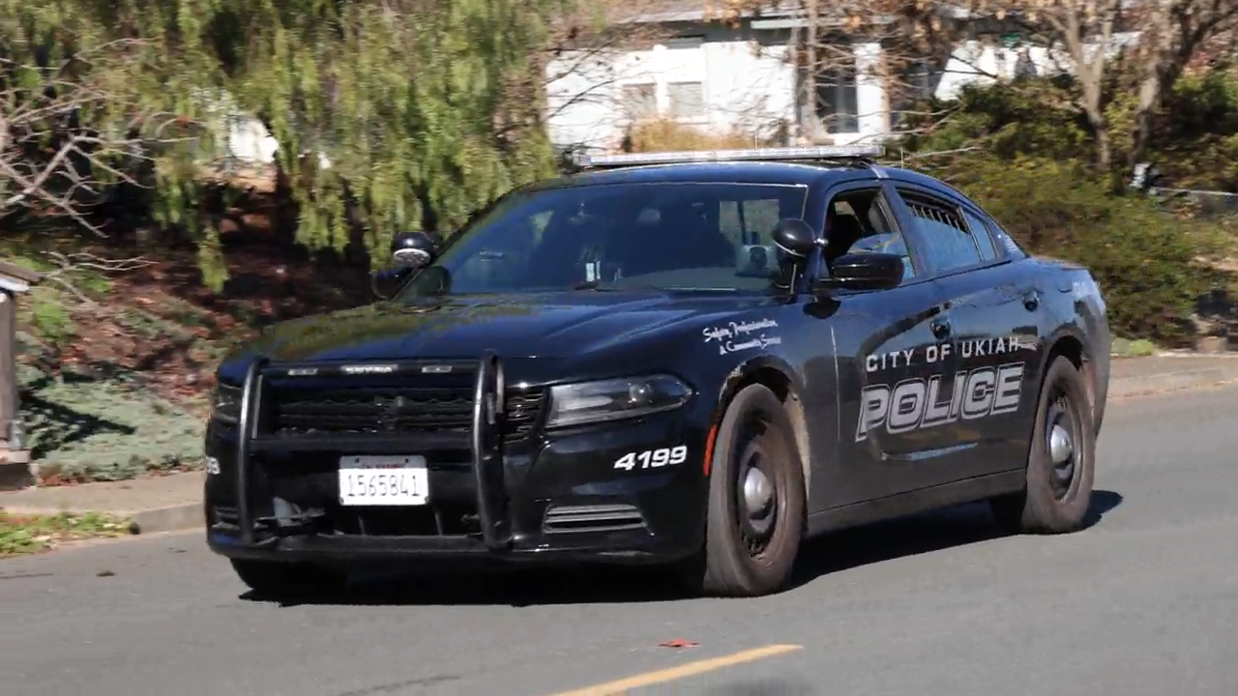
Crime Stats
2025
2024
755 Misdemeanor Arrests
804 Felony Arrests
*Prop 36 increased felony arrests
58 DUI’s
*Visible Higher Staffing acts as Deterrent
2,995 Reports Taken / 1,551 Cases Submitted to District Attorney
125 Traffic Collisions
*Targeted Enforcement/Roadway improvements
700 Misdemeanor Arrests
664 Felony Arrests
89 DUI’s
2,779 Reports Taken / 1417 Cases Submitted to District Attorney
335 Traffic Collisions

Slide 5
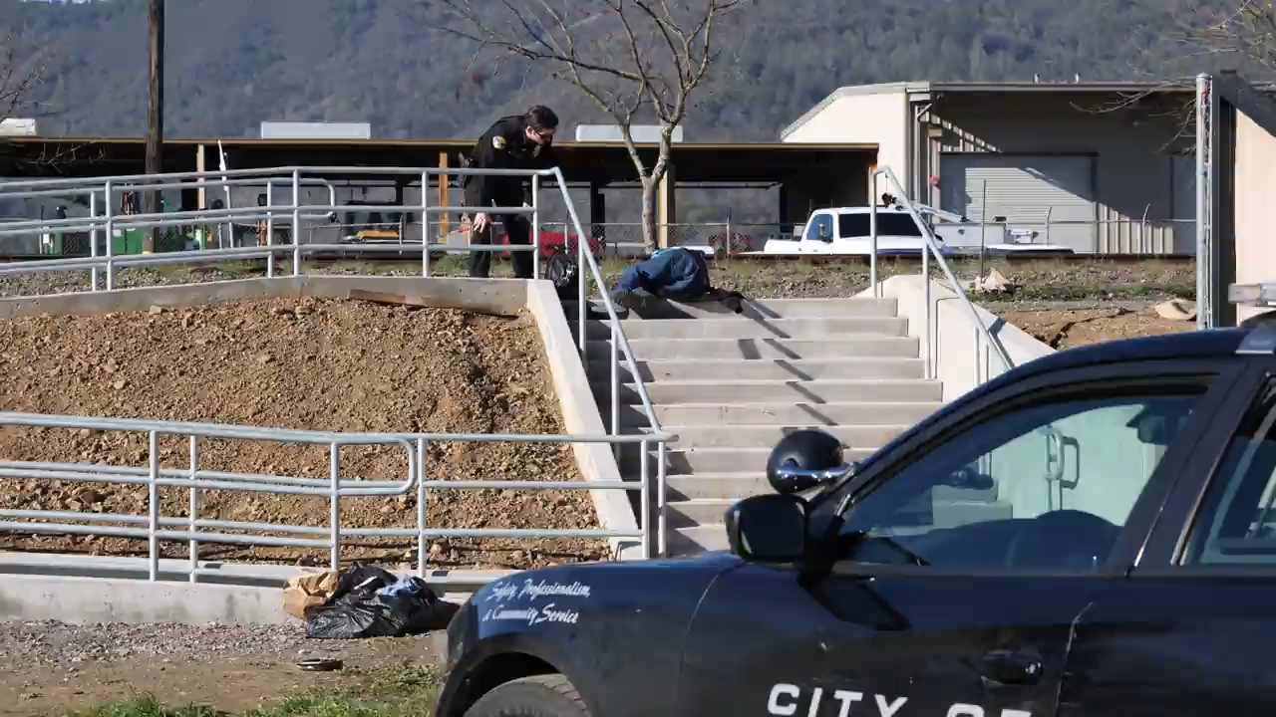
Top 10 Types of Calls
  1. Disturbance (1035)
  2. Trespass (844)
  3. Suspicious Circs (824)
  4. Alarm (682)
  5. Animal (544)
  6. Medical Aid (443)
  7. Welfare Check (411)
  8. Theft (392)
  9. City Code Violation (385)
  10. Suspicious Person (340)

Slide 6
Dispatch
2025
2024
  Dispatch received 64,173 total calls
  14,531 were for 911
  49,642 were non-emergency in nature.
  In 2025, 99.72% of all 911 calls were answered in under 15 seconds (State law requires minimum of 90%)
66,684 total calls
14,298 911 calls
52,386 non-emergency calls
In 2024, 99.56% of all 911 calls were answered in under 15 seconds
*FUN FACT* The busiest day of 2025 in dispatch occurred on January 2nd, with 178 calls received within a 24-hour period.

Slide 7
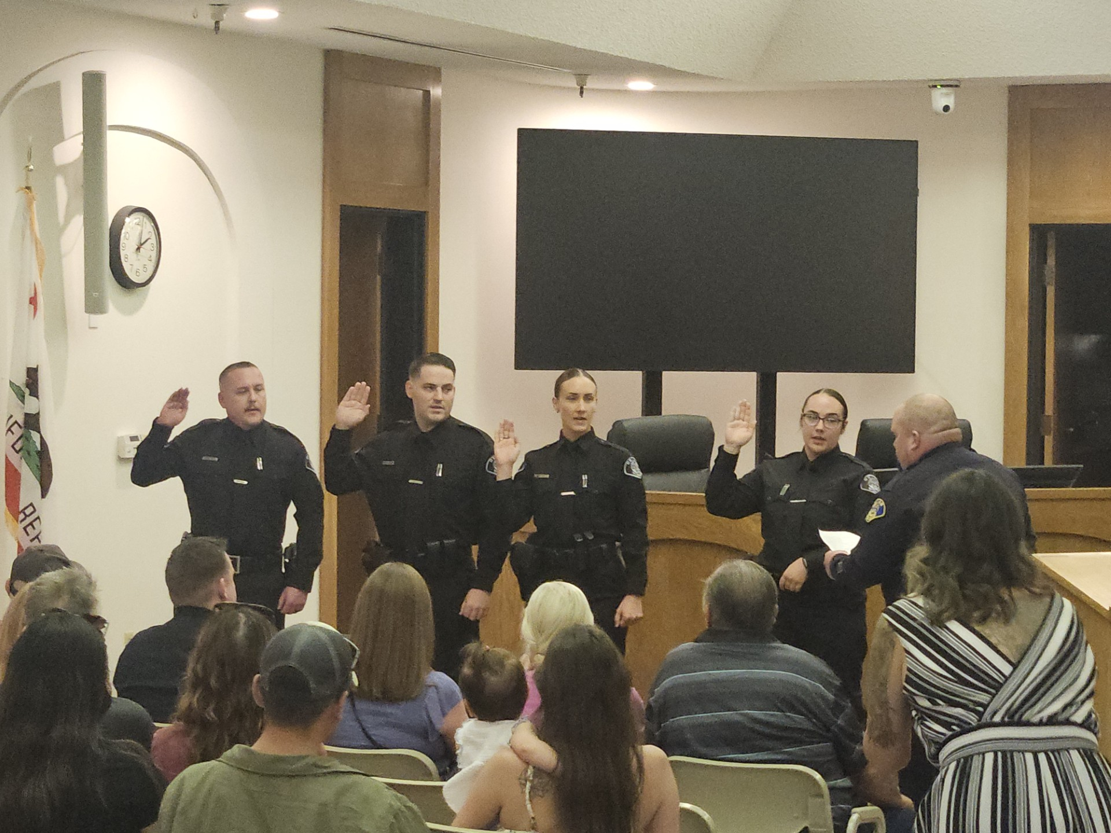
Recruiting/Hiring
7 Officers hired
5 Dispatchers hired
1 Community Service Officer hired
New recruiting strategies were implemented during the year and have proven effective. Dispatch is now fully staffed, and Patrol is currently one officer away from full staffing. As a result of increased hiring, positions that were previously vacated—such as School Resource Officer, Major Crimes Task Force, and additional detective assignments—have been successfully filled.

Slide 8
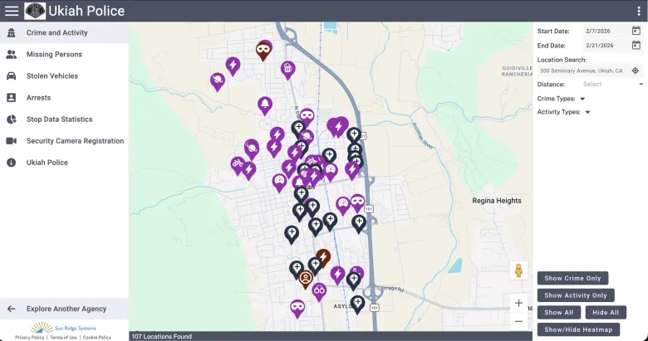
Accomplishments
Computer-Aided Dispatch System Implementation
The Police Department implemented a new computer-aided dispatch system that improves response times and provides enhanced tools, including crime mapping, to support more efficient and effective service to the community.
Police Department Web Page Redesign
A new Police Department web page was developed to provide up-to-date information and improved online tools, increasing public access to police services and enhancing community communication.
Recruitment and Staffing Improvements
Recruitment was prioritized, resulting in increased staffing levels and the successful filling of previously vacant positions, strengthening operational capacity.

Slide 9

THANK YOU
Ukiah Police Department
300 Seminary Ave.
Ukiah, CA. 95482
Non-Emergency: 707-463-6262
Ukiahpolice.com

